Slide 1

IoT Gateways
Connecting to Internet

Slide 2
Agenda
Understand Gateway roles
Bridging IP and Non-IP networks
Eclipse Kura

Slide 3
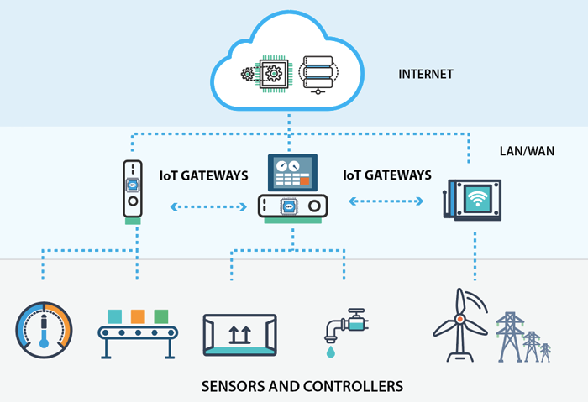
Overview

Slide 4

Gateway requirements
Many IoT devices/sensor node supports different protocols
Number of such devices could be huge
A tool to implement Edge Processing power
Provides a central point for cloud communication, so more control over security
Saves network bandwidth

Slide 5
So Gateway exactly is…
Any hardware device capable of communicating between non-IP network and IP network devices and performs some basic tasks on data streams, configuration
Ex: Rpi, Beaglebone

Slide 6
Basic Features
Device to Device or Device to Cloud communications
Data pre-processing, filtering
Buffering and Streaming
Secure access to network and devices
Configuration tools
Advance features – ML models

Slide 7
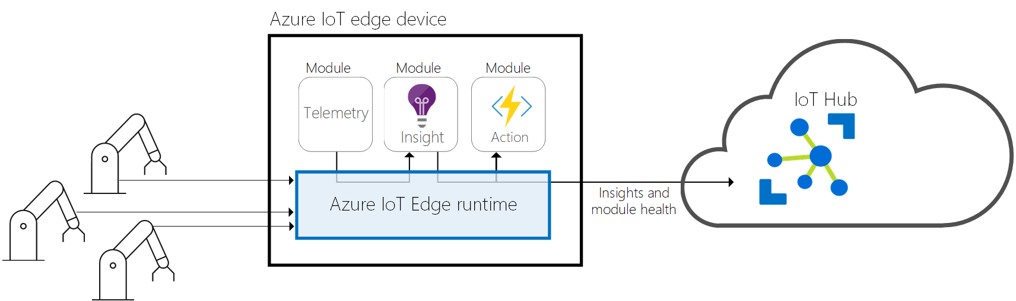
Azure IoT Edge Overview

Slide 8
Azure IoT Edge
Analytics at the edge
Downstream device isolation
The gateway device can shield all downstream devices from exposure to the internet
Connection multiplexing
All devices connecting to IoT Hub through an IoT Edge gateway can use the same underlying connection
Traffic smoothing
The IoT Edge device will automatically implement exponential backoff if IoT Hub throttles traffic, while persisting the messages locally.
Offline support
The gateway device stores messages and twin updates that cannot be delivered to IoT Hub.

Slide 9

Eclipse Kura Overview
Helps to abstract and isolate the developer from -
Complexity of the hardware
Networking sub-systems, re-define the development
Re-usability of integrated hardware and software solutions
It is an Eclipse IoT project that provides a platform for building IoT gateways
It is enables remote management of such gateways and provides a wide range of APIs for allowing you to write and deploy your own IoT application

Slide 10
References
Overview Image: https://openautomationsoftware.com/open-automation-systems-blog/what-is-an-iot-gateway/
Azure IoT Edge Image: https://docs.microsoft.com/en-in/azure/iot-edge/about-iot-edge?view=iotedge-2020-11

